Slide 1
PAYCHECK IN HCM
PROFESSIONAL DEVELOPMENT, JANUARY 7, 2024

Slide 2
EARNINGS CODES
AG OVERTIME - Overtime that does not meet Federal, State or Ed Code; pay is per bargaining agreement.
AWOP – Absent without pay
CA OVT .5 – Overtime for time and half.
CASH IN LIEU – Employees who came under the health and welfare cap, receives $105.54/month.
HOLIDAY – Holiday pay
LONGEVITY – Longevity paid each pay period.
ON CALL – Maintenance and Operations on call pay.

Slide 3
EARNINGS CODES CONTINUED..
OTHER - Other pay periods that cannot be displayed due to the limited space.
REGULAR PAY – For regular assignment hours
RET NSUB – Earnings are not subject to retirement contributions.
RET SUBJECT – Earnings are subject to retirement contributions.
SICK PAY – Earns one (1) day for every month of employment, prorated by fte.
STRAIGHT TIME – Earnings for extra hours
VAC PAY – Vacation Pay

Slide 4
Regular Pay Sample
Green/Pink
White
Absence Form
New: Hours under REGULAR PAY, please disregard hours for regular monthly position. It will not tie to the hours that you work for the month. LACOE use these hours as a factor to prorate the correct amount in EARNINGS for the month and it can vary month to month. The hours do not reflect the hours worked.
Notes:
Vacation and Sick Pay are subtracted off of the total regular pay

Slide 5
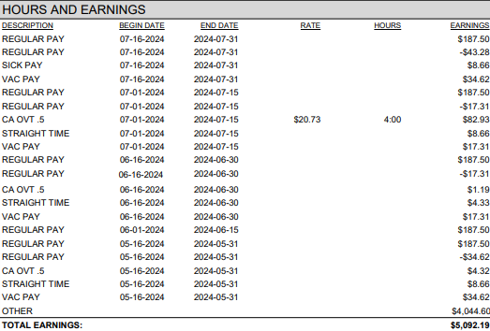
Retro Pay Sample
Sick, Vacation, and Regular Pay for the same day (7/16) nets to zero
Vacation Pay less Regular Pay for the same day nets to zero
Paystub ran out of space. Retro amount reflect applicable pay period between July 1, 2023 to May 15, 2024. “Other” for all other periods.
Retro Amount
Notes:
Vacation and Sick Pay are subtracted off of the total regular pay

Slide 6
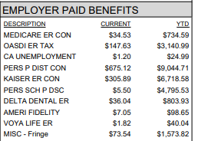
Employer Portion
Notes:
MISC fringe are all others such as worker’s comp, state unemployment benefits. All others that the district covers.

Slide 7
Employee Portion
Notes:
Optional benefits coverages, income protection, and voluntary deductions.

Slide 8
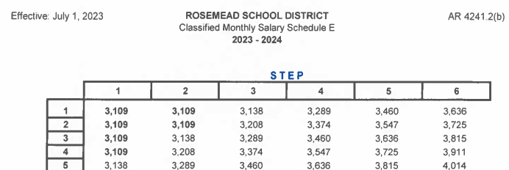
How to calculate monthly to daily and to hourly
Step 1: Go to district website, Human Resource Dept: : https://www.rosemead.k12.ca.us/domain/307
Download your Salary Schedule🡪 Find your pay Range and Step
For example:
Schedule E, Step 5,
Range 6: $4,014
Step 2:
Use Salary Conversion table to calculate rate per day or hour.
SALARY CONVERSION | Factors | Sample Calculation, approximately
Classified Monthly to Daily | Divide by 21.667 | $4,014/21.667=$185.26
Classified Monthly to Hourly | Divide by 173.33 | $4,014/173.33=$23.16

Slide 9
Friendly Payroll Reminders
Ensure to take 30 minute lunch breaks and record the time on the timesheets when 5 hours or more have been worked in a day.
To avoid any delays in payment, be sure to double-check your time reported is correct and total is accurate in hours and minutes. Remember to sign and date before turning it into your timekeeper/supervisor.
When you are absent, be sure to submit a completed Absence Forms along with your timesheet to your timekeeper/supervisor.

Slide 10
Friendly Payroll Reminders Continued…
Timekeepers
Remember to attach the absence forms to the appropriate Green or Pink timesheets.
Sort timesheets alphabetically, matching green with green, pink with pink, and white with white.
Ensure a copy of the EAF is attached with the Extra Hour/OT timesheets. Failure to do so can result in a delay in payment.
Notes:
The inputting procedure would be greatly accelerated by this.

Slide 11
Thank you!

